Slide 1

Multi-Scale Estimation of Crop Yield
Jiena He
Zhenhua Meng

Slide 2
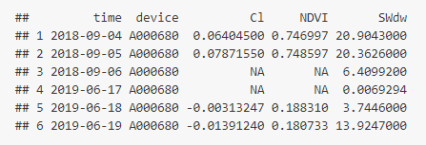
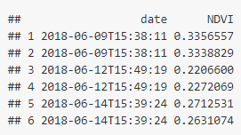
Data
Part 1: Pod Data
Part 2: Pod Data
Daily
Daily
Problems:
Missing data
Repeated data (Sentinel 2)

Slide 3
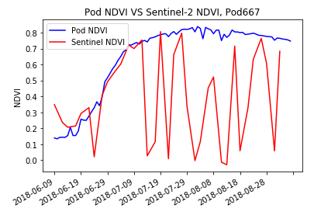
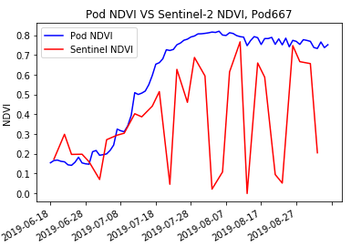
P667 location

Slide 4
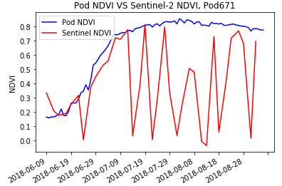
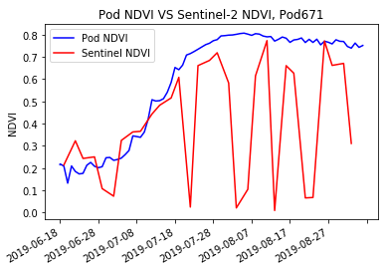
P671 location

Slide 5
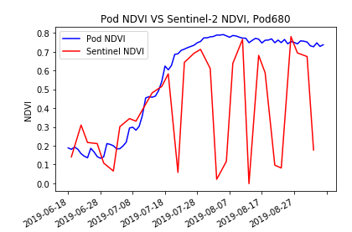
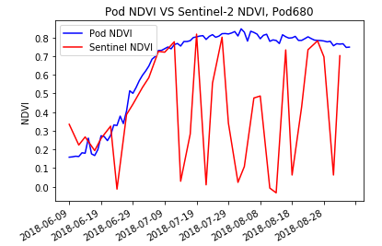
P680 location

Slide 6
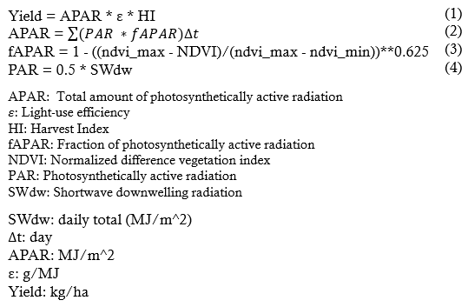
Methodology
Based on (1) and (2):
(ε = 4.2, HI = 0.4)

Slide 7
Workflow
Pod Data
Sentinel2 Data
Read Data
Pod
Sentinel2
Data Processing
(Interpolate missing values)
Data Processing
(Aggregate repeated date,
Filter valid data,
Interpolate missing values)
Calculation
Predicted Yield

Slide 8
Results : Zhenhua
Method
Pod data: Linear interpolation
Sentinel data: Linear interpolation
 | Pod yield |  | Sentinel yield
 | 2018 | 2019 | 2018 | 2019
P667 | 9908.912 | 7806.244 | 9062.246 | 6649.619
P671 | 9630.007 | 8049.265 | 9279.991 | 6604.041
P680 | 9512.559 | 7677.303 | 9386.693 | 6842.636

Slide 9
Results: Jiena
Method
Pod data: Nearest interpolation
Sentinel data: Linear interpolation
 | Pod yield |  | Sentinel yield
 | 2018 | 2019 | 2018 | 2019
P667 | 9908.912 | 7836.239 | 9341.155 | 7062.663
P671 | 9630.007 | 7950.582 | 9225.958 | 7377.418
P680 | 9512.560 | 7739.666 | 9356.743 | 6617.732

Slide 10
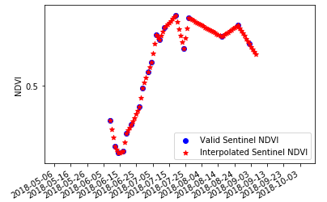
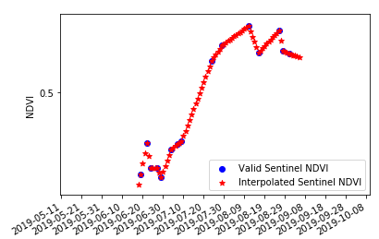
P667 location
Sentinel 2018
Sentinel 2019

Slide 11
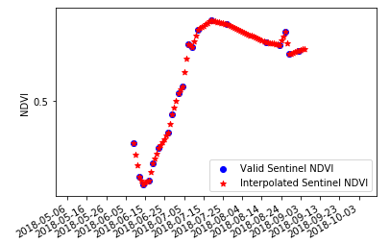
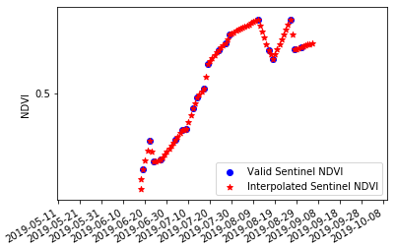
P671 location
Sentinel 2018
Sentinel 2019

Slide 12
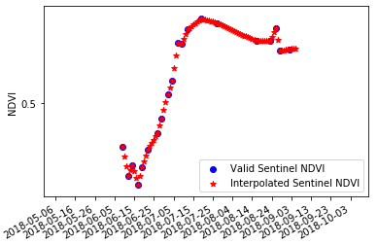
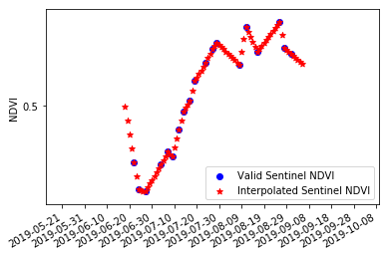
P680 location
Sentinel 2019
Sentinel 2019

Slide 13
Results: : Jiena
Method
Pod data: Nearest interpolation
Sentinel data: Nearest interpolation
 | Pod yield |  | Sentinel yield
 | 2018 | 2019 | 2018 | 2019
P667 | 9908.912 | 7836.239 | 9561.352 | 7077.815
P671 | 9630.007 | 7950.582 | 9326.752 | 6982.056
P680 | 9512.559 | 7739.666 | 9455.987 | 6562.333

Slide 14
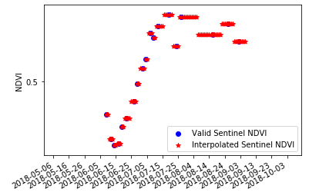
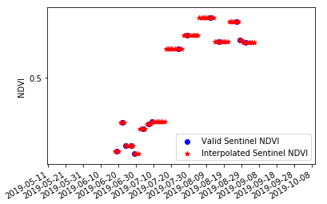
P667 location
Sentinel 2018
Sentinel 2019

Slide 15
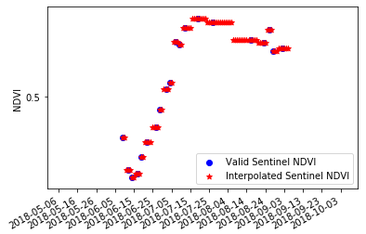
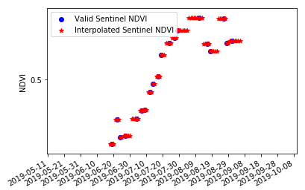
P671 location
Sentinel 2018
Sentinel 2019

Slide 16
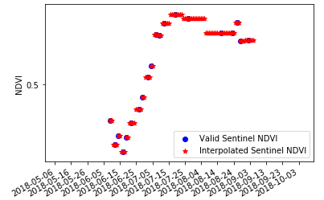
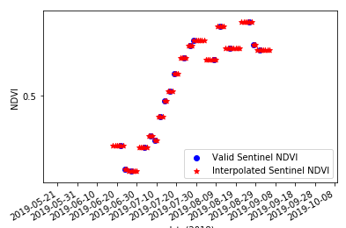
P680 location
Sentinel 2018
Sentinel 2019

Slide 17
Conclusion
1. In this project, NDVI value is the key point for predicting crop yield.
2. For Sentinel data, atmosphere impacts the quality of data and the final prediction.
3.The results from Sentinel and Pod data are very close. Thus, using Sentinel data to calculate predicted yield is feasible.
- Zhenhua Meng (Rscipts, Report, slides)
- Jiena He (PythonScripts, Report, slides)

